Slide 1

A COMPENDIUM · JULY 2026
How AI-Driven Conclusions Get Validated,
and What Comes Next
Companion to the whitepaper "You Cannot Grade Your Own Exam: Why Physical AI Needs Independent Verification"
Mike Vildibill
Founder and Principal, NeoVerity Group · CC BY 4.0
Notes:
Companion deck to the whitepaper. Present any slide, in whole or in part, with attribution.

Slide 2

FRAMEWORK
HOW TO USE THIS DECK
Take what you need. Keep the attribution.
This deck is published under Creative Commons Attribution 4.0 (CC BY 4.0). You may present any slide, in whole or in part, in your own materials, including commercially. The one condition is that you credit NeoVerity Group.
Every content slide is labeled with the kind of claim it makes, so a slide lifted on its own still tells you how much weight it carries.
EVIDENCE
Cited evidence
FRAMEWORK
Our organizing framework
ANALYSIS
Our analysis of cited material
VIEW
Our considered view
OUTLOOK
Our forecast, not a finding
How AI-Driven Conclusions Get Validated · CC BY 4.0
2

Slide 3
FRAMEWORK
CONTENTS
The argument, in five moves
I
The claim
A system cannot corroborate itself, and now it acts on the world
II
Why it happens
The mathematics of correlated error, and how independence gets faked
III
What good looks like
An independent verification layer, and the doctrine that already mandates it
IV
Applying it
What to ask, where the function sits, and where to start
V
What comes next
Where verification practice is heading, and how we could be wrong
How AI-Driven Conclusions Get Validated · CC BY 4.0
3

Slide 4
EVIDENCE
PART I · THE CLAIM
A system cannot corroborate itself
A single model reasons with one set of weights, so it has one set of blind spots. Asked to verify its own work, it mostly confirms itself.
EXAM
A+
Self-agreement certifies confidence, not correctness.
SUBMITTED BY & GRADED BY
No amount of scale changes that. Fluent, confident and wrong is still wrong.
THE SAME AI MODEL
THE MATH IS OLD AND SETTLED
Ensemble error = bias² + (1/M) · variance + (1 − 1/M) · covariance
Copies of the same model shrink variance. The covariance term does not shrink, so correlated errors cannot be averaged away.
How AI-Driven Conclusions Get Validated · CC BY 4.0
4
Notes:
Ueda & Nakano 1996. The covariance term is the whole argument.

Slide 5
EVIDENCE
PART I · THE CLAIM
Why it matters now: a wrong answer becomes a wrong outcome
AI first transformed language: drafting, summarizing, reasoning over text. A confident but wrong answer there costs a rewrite.
Increasingly, AI is asked to act on the physical world: propose molecules, accelerate simulations, tune processes, inform engineering and safety decisions. There, wrong answers become wrong outcomes.
A failed experiment
A flawed design
An unsafe action
wasted time, materials, and a result nobody can trust
a fault carried forward into something that gets built
a control decision taken on a wrong reading of the world
Physical AI: machine learning combined with simulation, data, and domain knowledge to model, predict, or control the physical world. Broader than robotics; no embodiment required.
How AI-Driven Conclusions Get Validated · CC BY 4.0
5

Slide 6
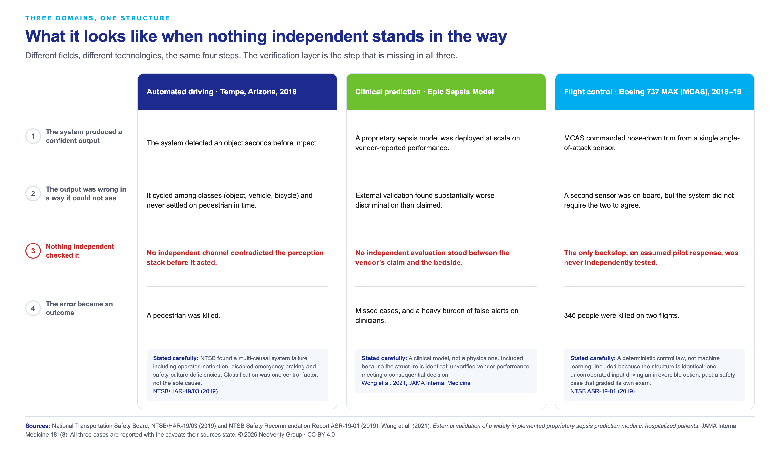
PART I · THE CLAIM
EVIDENCE
How AI-Driven Conclusions Get Validated · CC BY 4.0
6
Notes:
Three domains, one structure (Tempe, Epic Sepsis, MCAS). All three cases carry their sources caveats. Review carefully before presenting: slide leads with a fatality.

Slide 7
FRAMEWORK
PART I · THE CLAIM
Where Physical AI sits: three layers
One framework organizes everything that follows. HPC addressed Layer 2 in service of Layer 1. LLMs transformed Layer 3. Physical AI is where these layers converge and reinforce one another, and Layer 2 is where a claim gets checked against reality.
Layer 3: Descriptions of the world
language · LLM output
Layer 2: Models of the world
simulation · learned surrogates · the checking layer
Layer 1: The world
matter · energy · machines · cells · where consequences are real
Layer 2 checks Layer 3 against Layer 1. That check is the subject of this deck.
How AI-Driven Conclusions Get Validated · CC BY 4.0
7

Slide 8
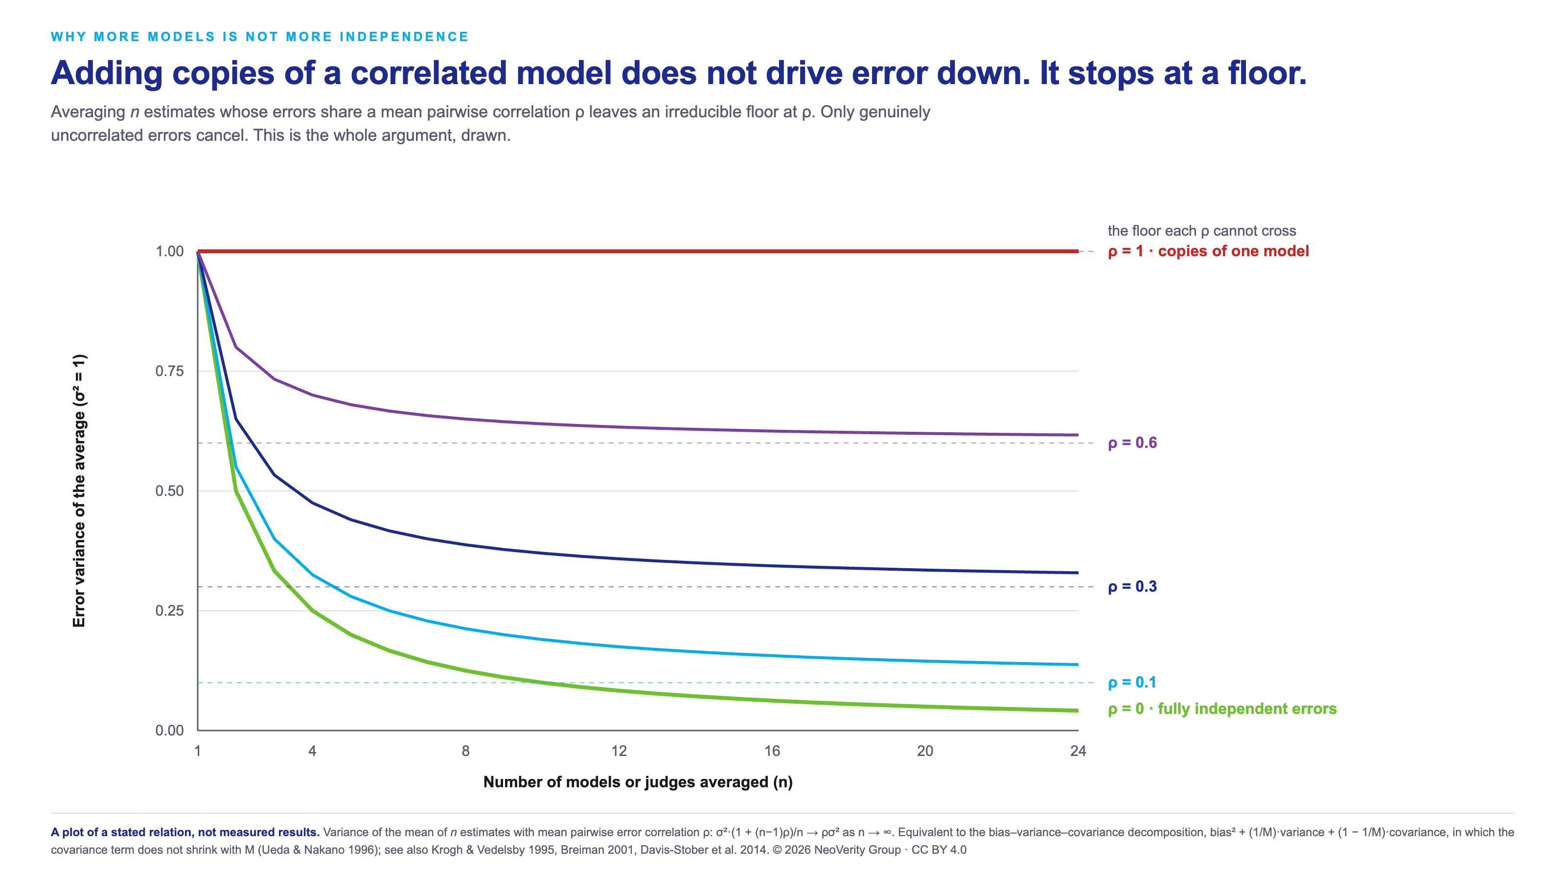
PART II · WHY IT HAPPENS
EVIDENCE
How AI-Driven Conclusions Get Validated · CC BY 4.0
8
Notes:
A plot of a stated relation, not measured data: variance of the mean = sigma^2 (1 + (n-1)rho)/n.

Slide 9
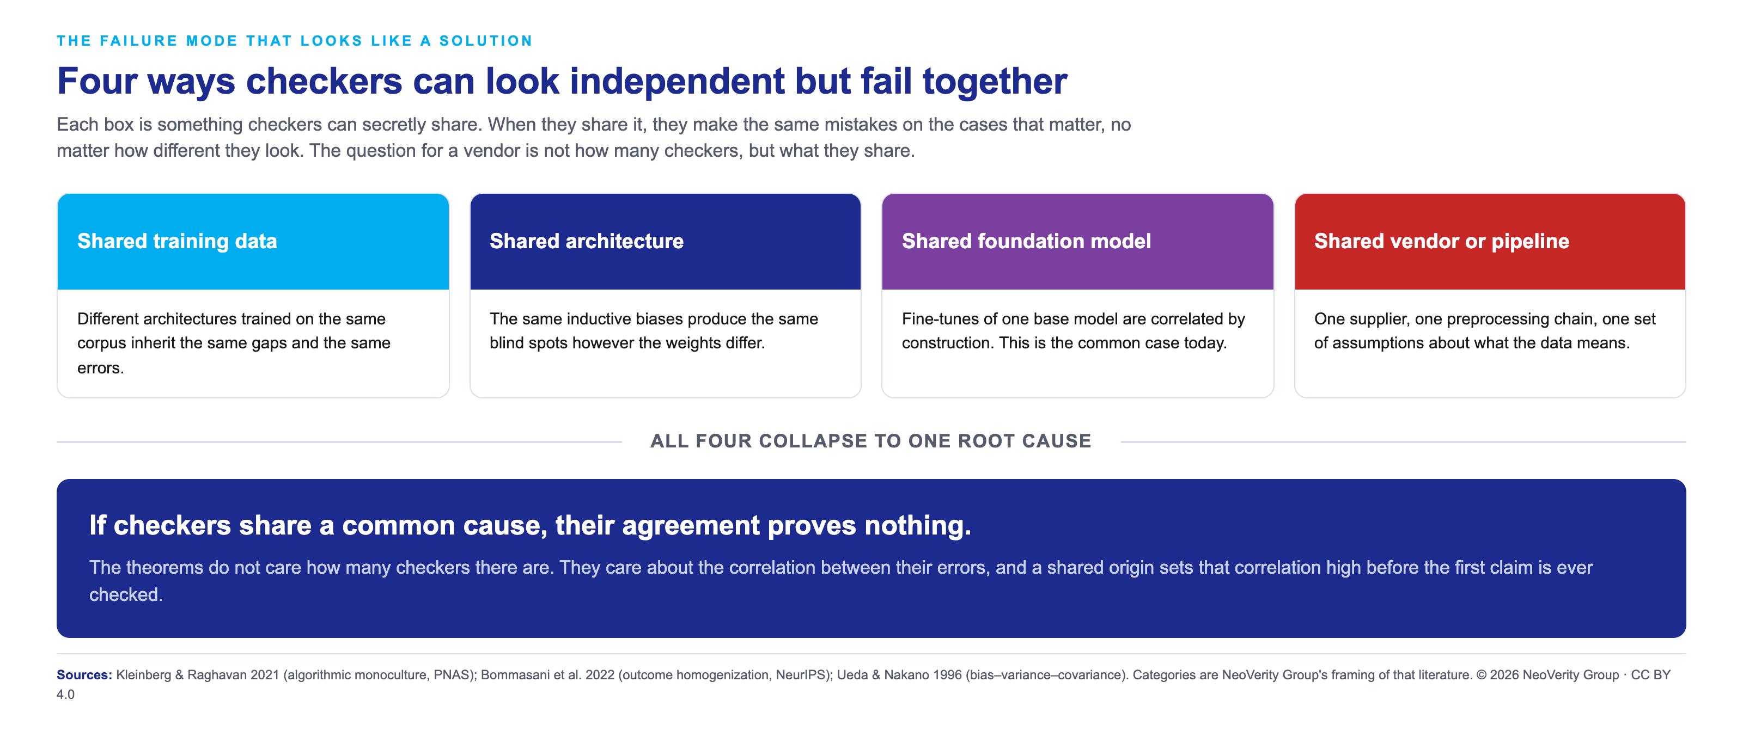
PART II · WHY IT HAPPENS
EVIDENCE
How AI-Driven Conclusions Get Validated · CC BY 4.0
9

Slide 10
FRAMEWORK
PART III · WHAT GOOD LOOKS LIKE
The answer: independent verification
A machine-generated claim
THE INDEPENDENT VERIFICATION LAYER
Checkers that fail differently from the system they verify.
Different blind spots
No common source
Independence is proven
each is wrong on different inputs, so one catches what another misses
not the training data, architecture, base model, or vendor
a property to be engineered and audited, never assumed
Cross-checked before it touches the physical world · Layer 1
"Differently wrong," not more of the same model. Agreement is informative only because the checkers fail in different ways. Agreement among correlated estimators is false comfort.
How AI-Driven Conclusions Get Validated · CC BY 4.0
10
Notes:
The layer is defined here by a property (error independence), not by a fixed roster of checkers. What it must not share: data, architecture, base model, vendor.

Slide 11
FRAMEWORK
PART III · WHAT GOOD LOOKS LIKE
The one property that makes it work: the checkers fail differently
Independence is not a count of checkers. It is whether they fail on the same inputs. The two panels below run two checkers over the same eight claims; the only difference is whether their errors overlap, and it flips their agreement from meaningless to real evidence.
Correlated checkers
Independent checkers
Checker A
✓
✓
✓
✗
✓
✗
✓
✓
Checker A
✓
✓
✓
✗
✓
✓
✓
✓
Checker B
✓
✓
✓
✗
✓
✗
✓
✓
Checker B
✓
✓
✓
✓
✓
✓
✗
✓
eight claims, checked left to right
eight claims, checked left to right
They agree, and are both wrong on claims 4 and 6. Agreement proves nothing.
They fail on different claims, so between them every claim is caught. Agreement is real evidence.
The difference between a bigger model and a verification layer is not how many checkers, but whether their errors overlap. That is error independence, and you get it by building checkers differently: different data, architecture, and approach.
How AI-Driven Conclusions Get Validated · CC BY 4.0
11
Notes:
Generic Checker A / Checker B, deliberately not a named roster. The point is the property (uncorrelated errors), which is the same principle the covariance figure states numerically.

Slide 12
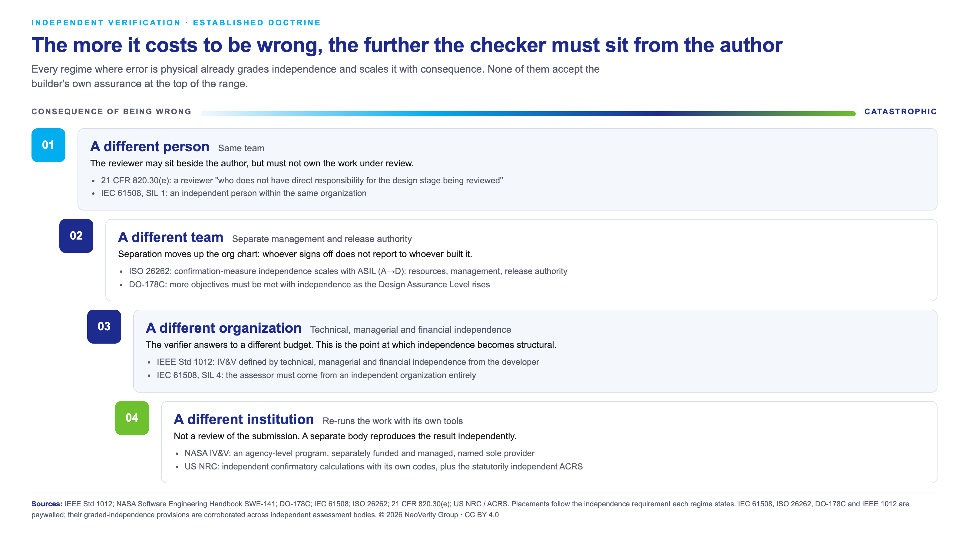
PART III · WHAT GOOD LOOKS LIKE
EVIDENCE
How AI-Driven Conclusions Get Validated · CC BY 4.0
12
Notes:
Every rung is attributable to a named published standard. Continuity, not invention.

Slide 13
VIEW
PART IV · APPLYING IT
What to ask a vendor
Independence is not a count of models. It is what those models do not share. Five questions separate a verification layer from a bigger one.
1
What do your checkers share?
Training data, architecture, base model, supplier, preprocessing. Shared anything is shared blind spots.
2
What single point of failure would make them all wrong at once?
If there is such a failure, the checkers are not independent, however many there are.
3
Which checker can overrule the model, and who does it report to?
A reviewer who reports to the builder is a courtesy, not a control.
4
What happens when the checkers disagree?
Disagreement should stop the claim, not get averaged into a confident number.
5
Can you show the verification evidence?
Or are we taking the accuracy figure on trust? The whole point is not to.
How AI-Driven Conclusions Get Validated · CC BY 4.0
13

Slide 14
VIEW
PART IV · APPLYING IT
Where the verification function has to sit
Independence is a property of reporting lines and budgets, not of good intentions. The standard that defines it names three, and they apply just as well inside an organization as between a buyer and a supplier.
Technical
Managerial
Financial
The verifier did not build the system, and independently determines whether it is correct.
Whoever signs off does not report to whoever ships. Sign-off cannot be pressured.
The verification budget is not controlled by the team being verified.
independence
independence
independence
An internal reviewer who can be overruled by the person they are checking is not independent verification. It is a courtesy that fails exactly when it matters.
Applies IEEE Std 1012's three-part definition of independence to an internal function.
How AI-Driven Conclusions Get Validated · CC BY 4.0
14

Slide 15
VIEW
PART IV · APPLYING IT
Starting without rebuilding everything
Verification is not free, and it does not belong everywhere. Apply it where mistakes are most costly and the action is expensive or irreversible. The first move is not to build a layer. It is to triage.
Low stakes, reversible
Self-check
A self-check is fine. Drafting, exploration, anything a human reviews before it acts.
High stakes, expensive
Independent check
An independent check before commitment. A design entering certification, a costly run.
High stakes, irreversible
Verification layer
Independent verification is not optional. Anything that touches Layer 1 and cannot be undone.
Verify what matters most. Know which decisions you cannot afford to get wrong, and put verification there first.
How AI-Driven Conclusions Get Validated · CC BY 4.0
15

Slide 16
EVIDENCE
PART V · WHAT COMES NEXT
What is already forcing the issue
This is not a forecast. It is the present-day landscape, and the direction of travel is observable in it.
AI now has management and risk standards
ISO/IEC 42001:2023 (AI management systems) and the NIST AI Risk Management Framework 1.0 exist and are being adopted. Standards for governing AI are emerging.
The field says its trust machinery is missing
The US National Academies' consensus study on digital twins names verification, validation and uncertainty quantification a foundational research gap. The field's own assessment: the machinery to trust these systems does not yet exist.
The gap between capability and assurance is widening
Deployment is outrunning verification. That gap is exactly where an independent layer becomes non-optional rather than nice to have.
Sources: ISO/IEC 42001:2023; NIST AI RMF 1.0; National Academies (NASEM 2024), Foundational Research Gaps and Future Directions for Digital Twins. All three are in the whitepaper's reference list.
How AI-Driven Conclusions Get Validated · CC BY 4.0
16

Slide 17
OUTLOOK
PART V · WHAT COMES NEXT
What we expect to become normal practice
These are directional claims, not findings. Each reasons forward from the landscape on the previous slide, or from the doctrine already in force where stakes are physical.
We expect: Independence becomes a procurement question
Buyers stop asking only "how accurate?" and start asking "independent of what?" It moves from an engineering preference to a purchasing requirement.
We expect: Verification evidence must be shown
The burden shifts. A vendor is expected to demonstrate the check, not assert the accuracy. "Trust us" stops clearing procurement.
We expect: Checkers face the same scrutiny as models
A checker's provenance, what it shares with the thing it checks, becomes as examined as the model's benchmark score. Correlation becomes a due-diligence item.
Marked Outlook: these are our forecast, offered with reasoning, not presented as established fact.
How AI-Driven Conclusions Get Validated · CC BY 4.0
17

Slide 18
OUTLOOK
PART V · WHAT COMES NEXT
What would have to be true for us to be wrong
This argument owes you the terms on which it would fail. We would change our view if any of these turned out to be true.
If correlated error becomes reliably correctable at scale
If a method emerges that removes shared error from copies of one model as dependably as independence does, the covariance floor stops binding.
If assurance does not follow capability
If regulation, procurement and practice do not move toward demanding independence, the direction on the prior slides is wrong.
If verification costs more than the errors it prevents
If, in most real deployments, an independent layer costs more than the failures it catches are worth, the economics do not support it.
None of these is true today. That is why we hold the view. It is also how you would know if it stopped being right.
How AI-Driven Conclusions Get Validated · CC BY 4.0
18

Slide 19
THE BOTTOM LINE
You cannot grade your own exam.
In the physical world, the cost of a wrong grade is not a wrong answer. It is a wrong outcome. Independent verification is structural, not optional, and a bigger model is not a verification strategy.
Read the whitepaper · neoverity.com/reports
CC BY 4.0

Slide 20
FRAMEWORK
SOURCES AND METHOD
How this deck was built, and how to check it
A deck arguing for verification should be verifiable. This is how it was made and what it rests on.
Claims are traced to primary sources.
Every evidence claim comes from the whitepaper's verified reference list. No new factual claims were introduced when the slides were made.
Paywalled standards are corroborated, not quoted from memory.
IEEE 1012, IEC 61508, ISO 26262 and DO-178C are behind paywalls; their graded-independence provisions are confirmed across independent assessment bodies.
Each slide states what kind of claim it is.
Evidence (cited), Framework (our structure), Analysis (our reasoning from cited work), View (our position), Outlook (our forecast). The forecast is never dressed as fact.
The figures are reproducible.
Every figure is generated from a committed script, so any number in them can be traced and any error corrected at the source rather than patched in the image.
This argues a principle, not a product.
The deck makes the case for independent, error-independent verification without prescribing what any particular verification layer should contain. Where a slide states our forecast, it is marked Outlook.
Full reference list: the whitepaper "You Cannot Grade Your Own Exam" at neoverity.com/reports. · Version July 2026. · © 2026 NeoVerity Group, CC BY 4.0.
How AI-Driven Conclusions Get Validated · CC BY 4.0
20

